Slide 1
Table of content:
Introduction
Thick- vs. thin-wall modelling
Experimental considerations
Viscoelasticity
Constitutive modelling in vivo

Slide 2
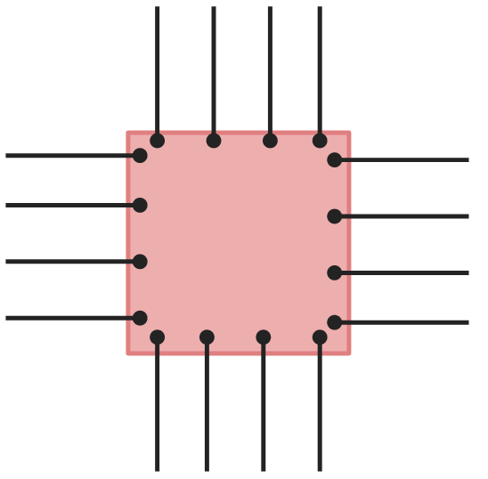
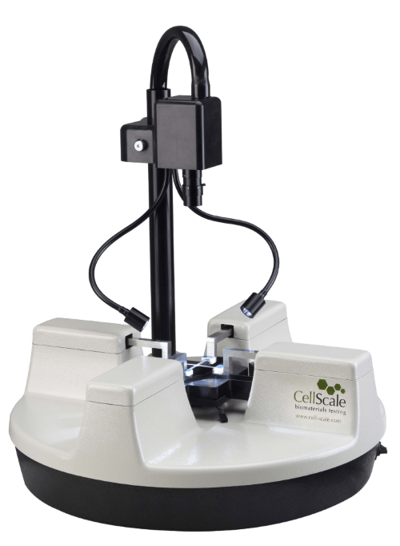
Planar biaxial testing: Experimental flexibility
?
=
Deformation field?
Stretched
Compressed

Slide 3

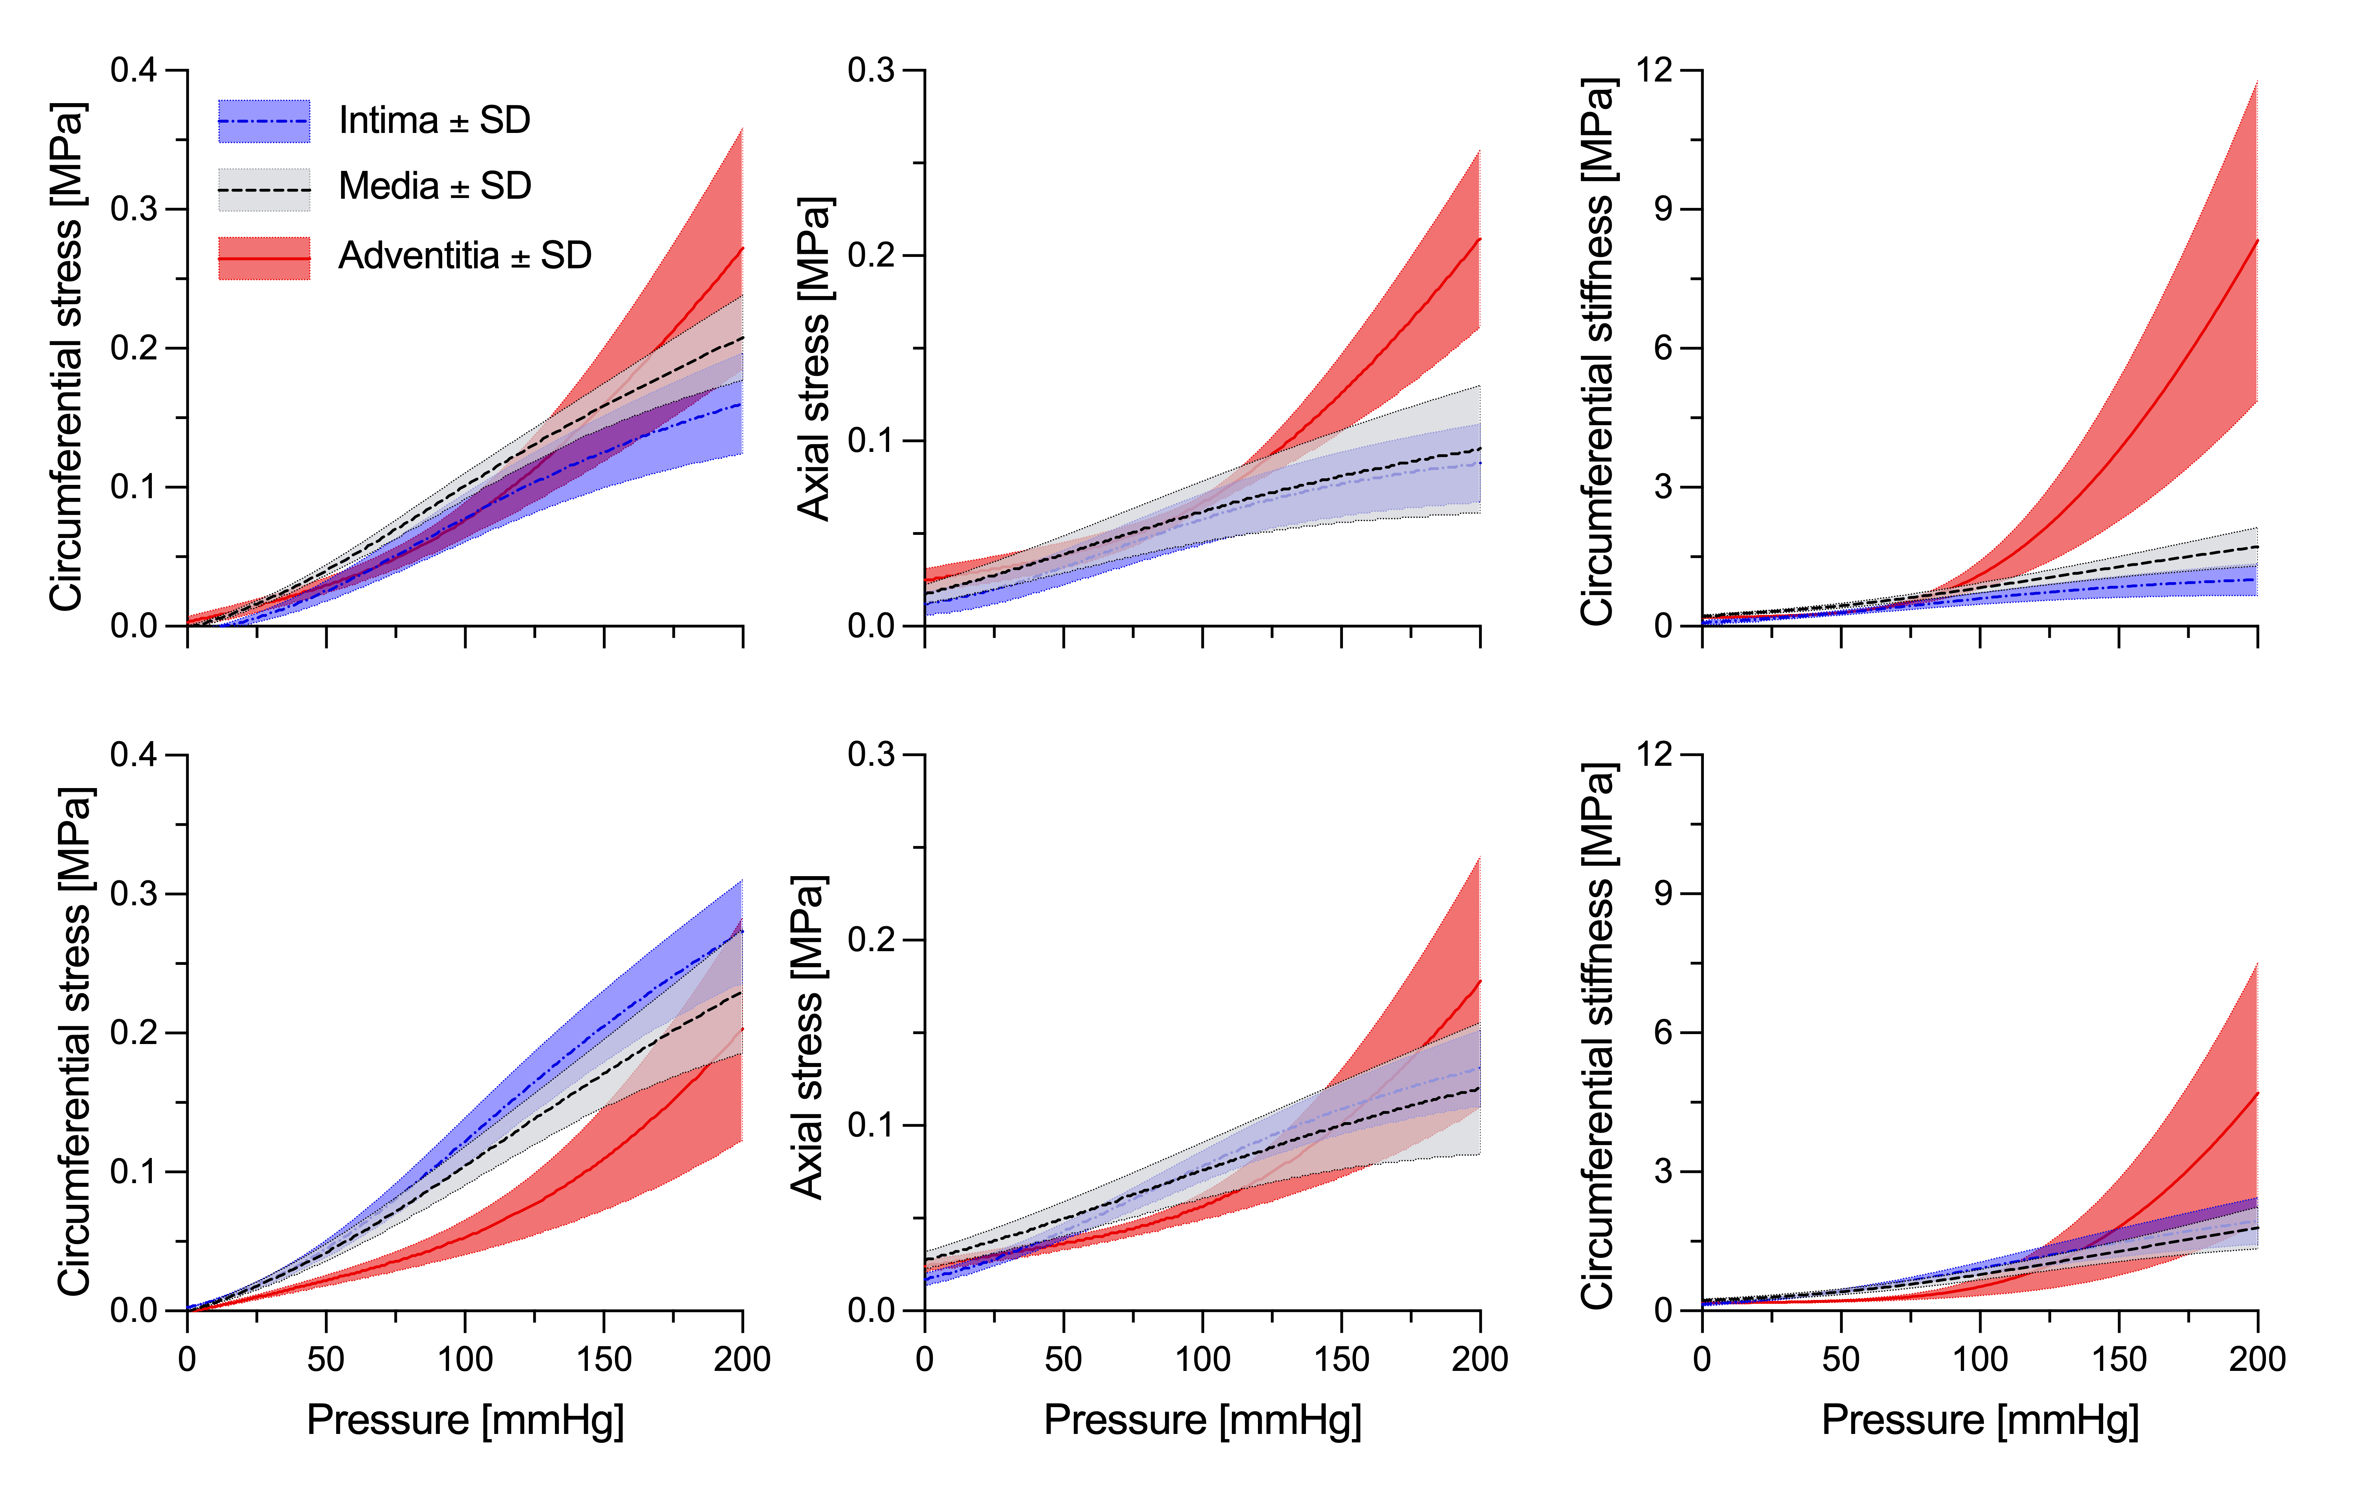
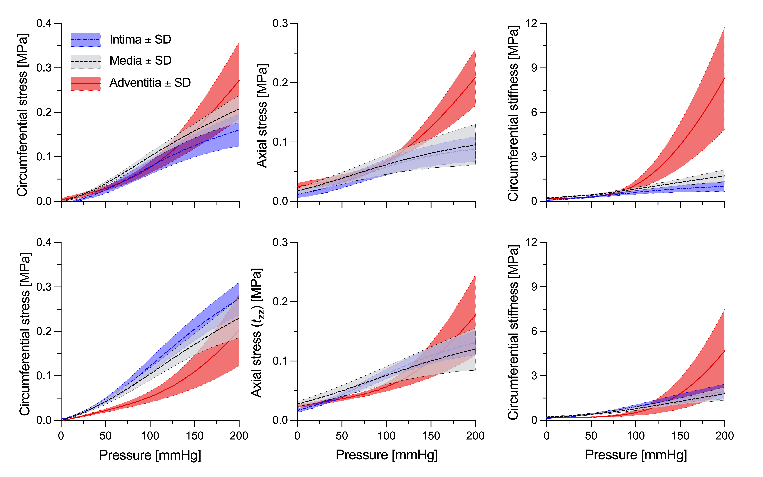
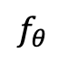
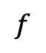
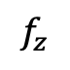

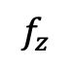
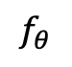
Planar vs. physiological biaxial testing
aorta
$$f$$
$$f$$
$$P$$
$$f_{z}$$
$$f_{θ}$$
$$f_{θ}$$
$$f_{z}$$
Giudici, Artery Res 2022, 28: 41:54.

Slide 4
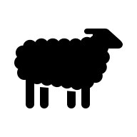
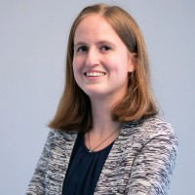
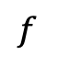
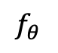

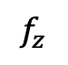
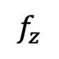
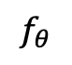
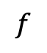
Planar vs. physiological biaxial testing
carotid
2
L = 105%
L = 100%
Inflation testing
$$f$$
L = 95%
$$f$$
$$P$$
Extension testing
Axial stretch
1.5
$$f_{z}$$
Planar biaxial testing
$$f_{θ}$$
$$f_{θ}$$
$$f_{z}$$
1
1.5
2
Cindy van Loo
Circumferential stretch

Slide 5

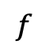
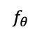
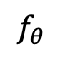
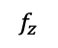

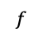
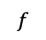
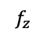
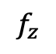
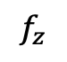

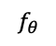
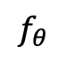
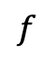
Planar vs. physiological biaxial testing
carotid
$$f_{z}$$
$$f$$
$$f_{θ}$$
$$f$$
$$P$$
$$f_{θ}$$
Simulation
(tube2planar)
$$f_{z}$$
$$f_{θ}$$
$$f_{z}$$
$$f$$
$$f$$
$$P$$
$$f_{θ}$$
$$f_{z}$$
Constitutive model 1
Constitutive model 2
Cindy van Loo
Simulation
(planar2tube)

Slide 6
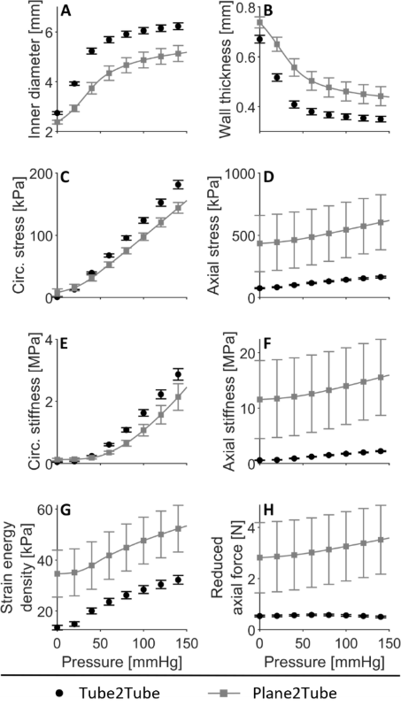
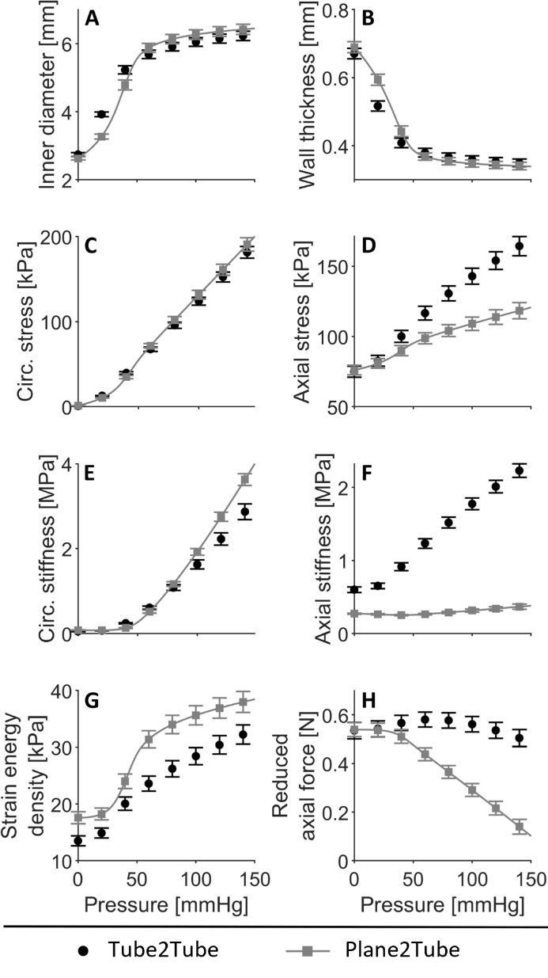
Planar vs. physiological biaxial testing
carotid
Four-fibre model to capture both datasets
(8 parameters).
Two-fibre model to capture the planar biaxial data
(4 parameters).
Cindy van Loo

Slide 7
Table of content:
Introduction
Thick- vs. thin-wall modelling
Experimental considerations
Viscoelasticity
Constitutive modelling in vivo

Slide 8

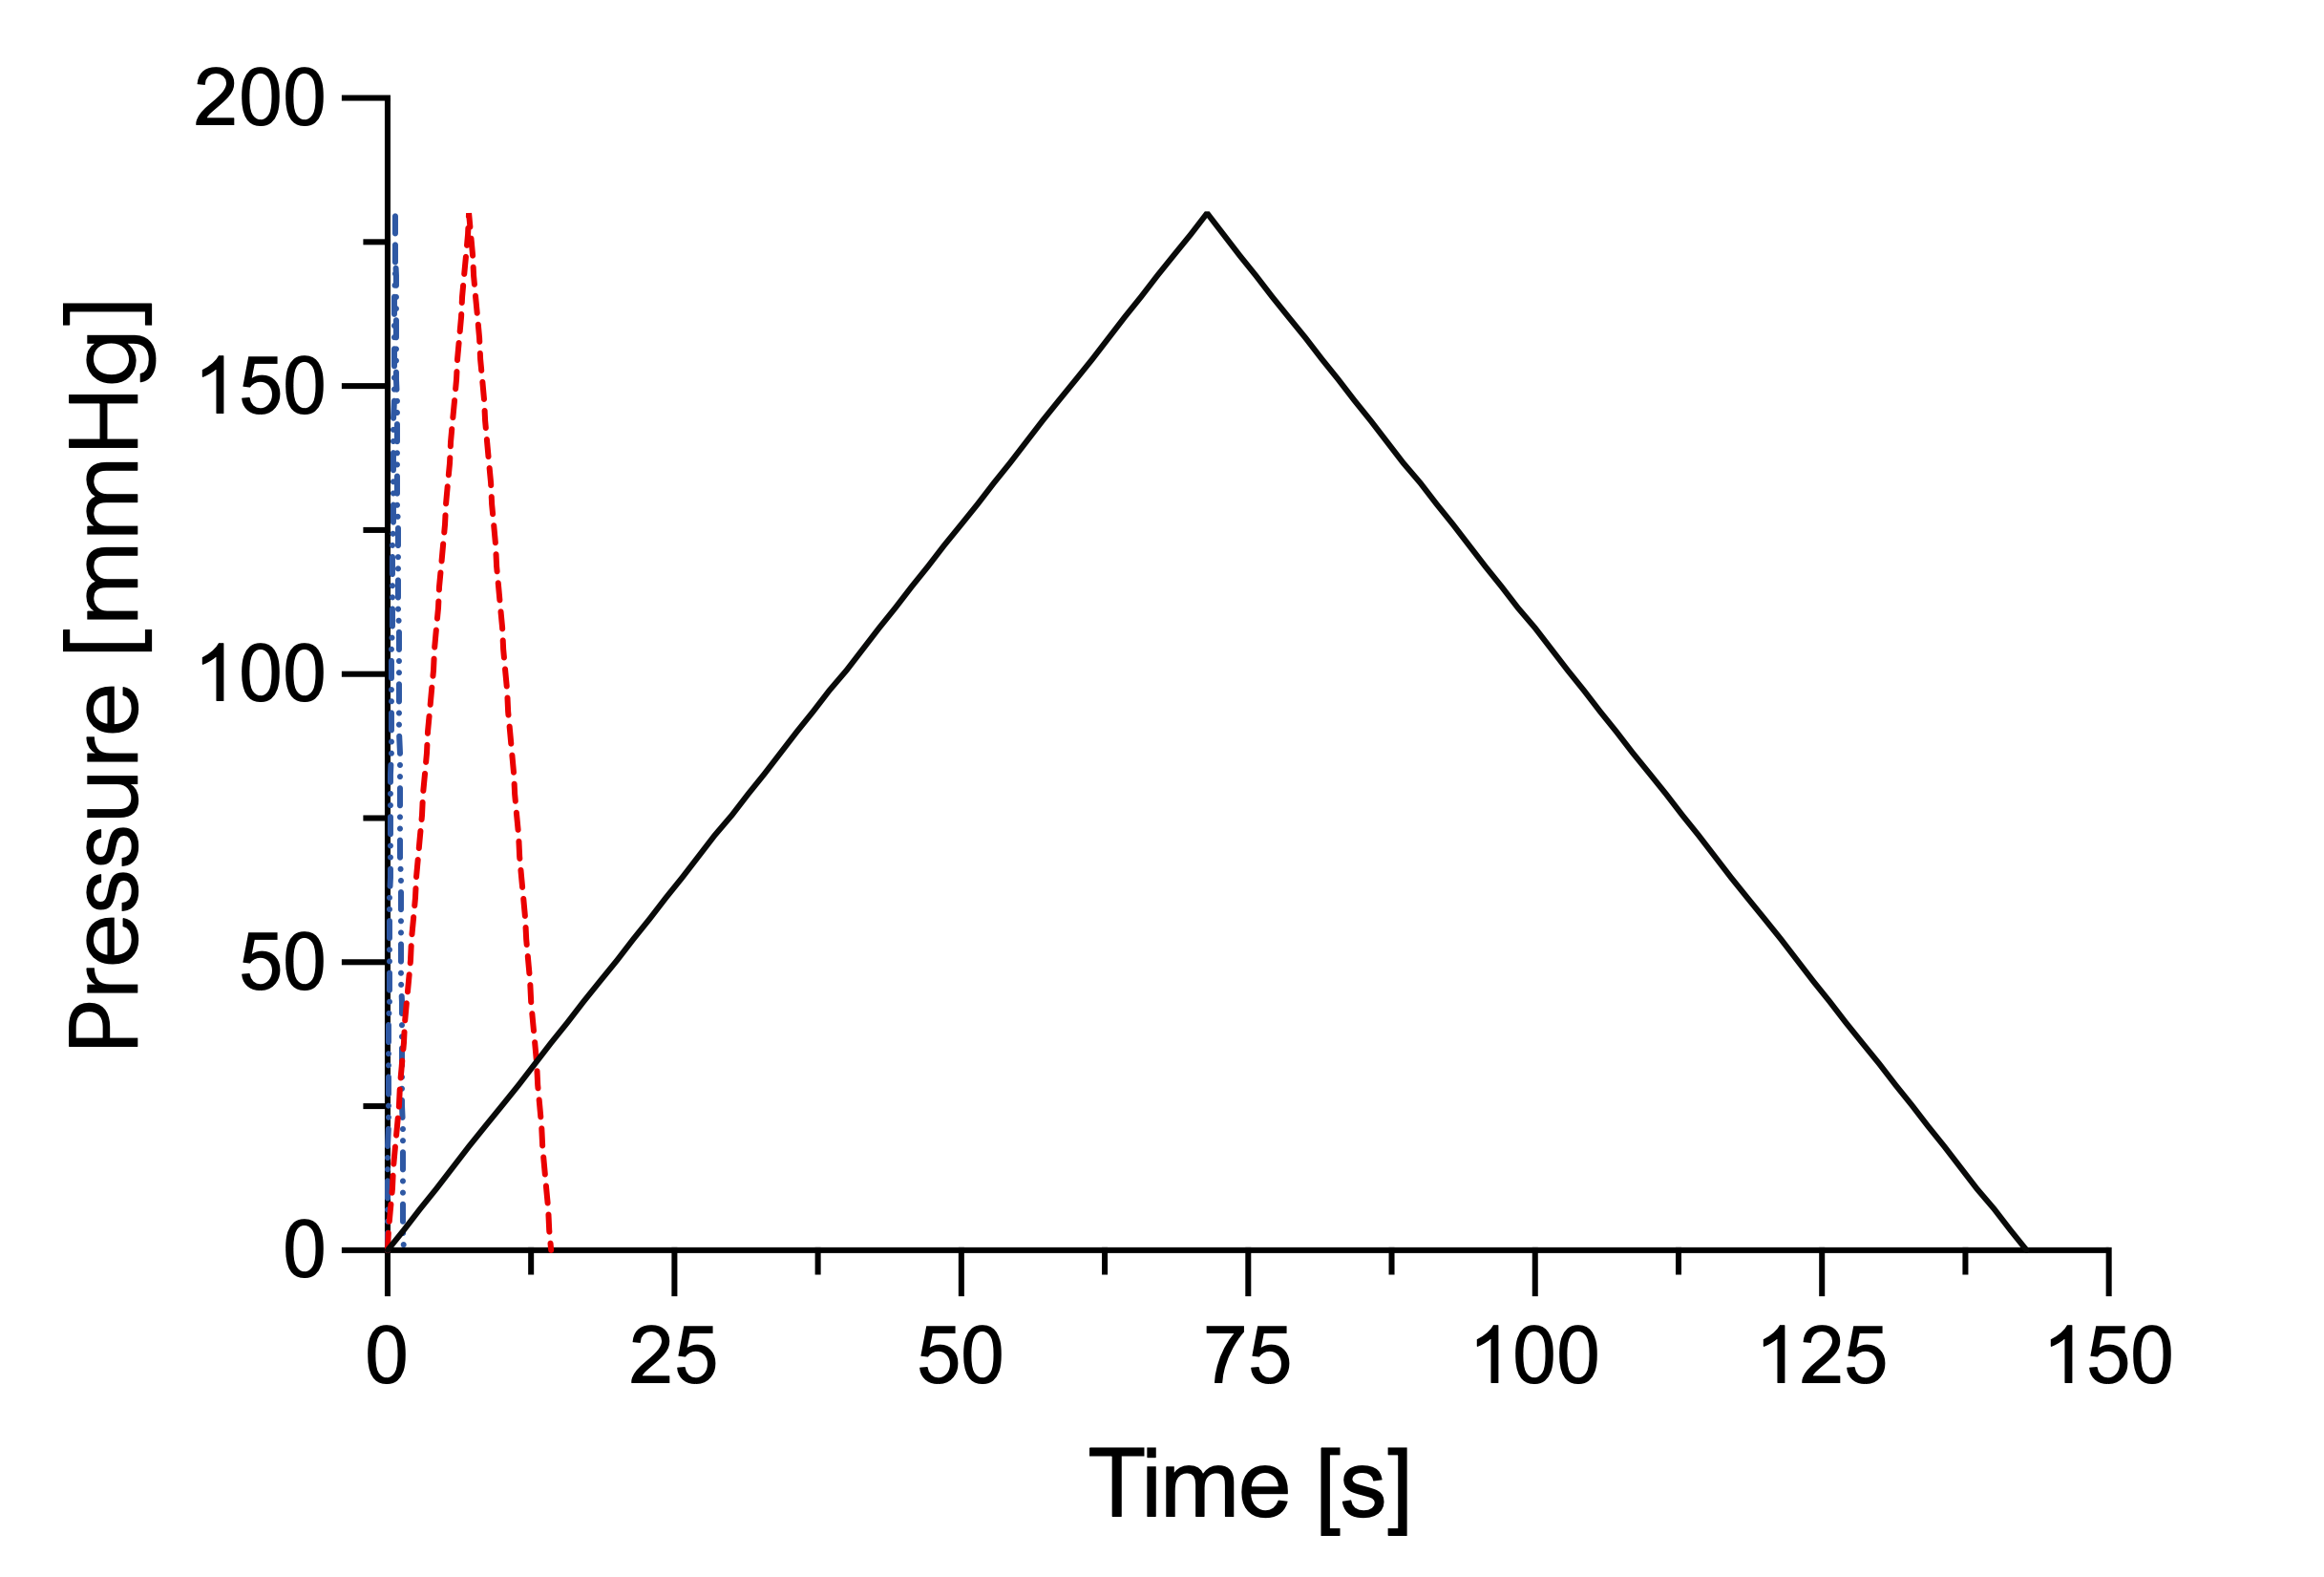
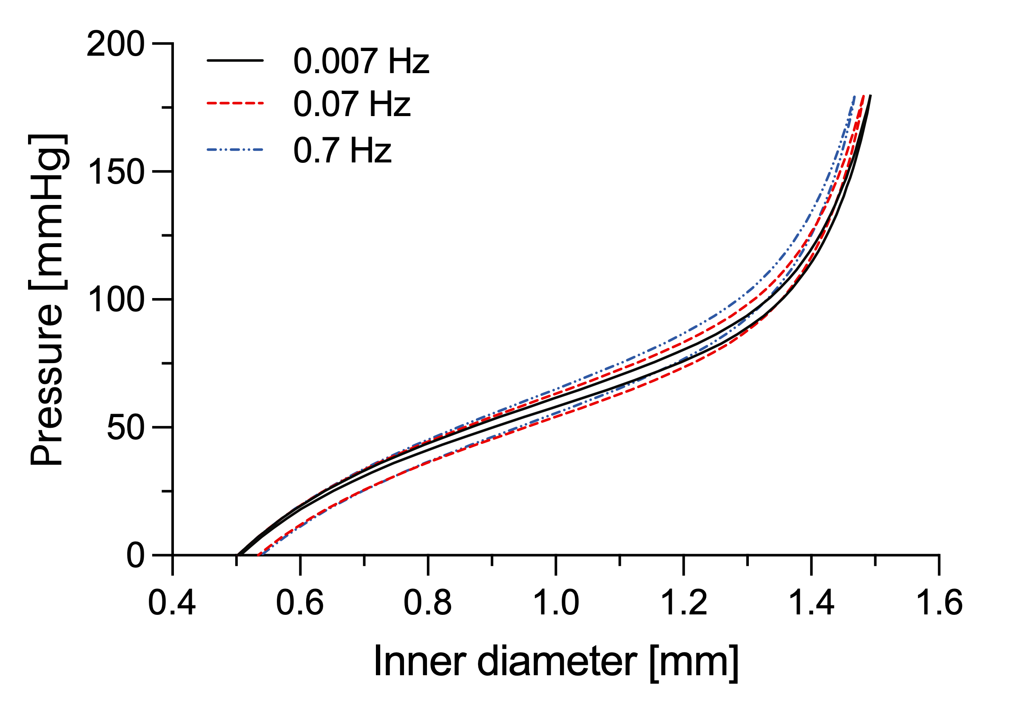
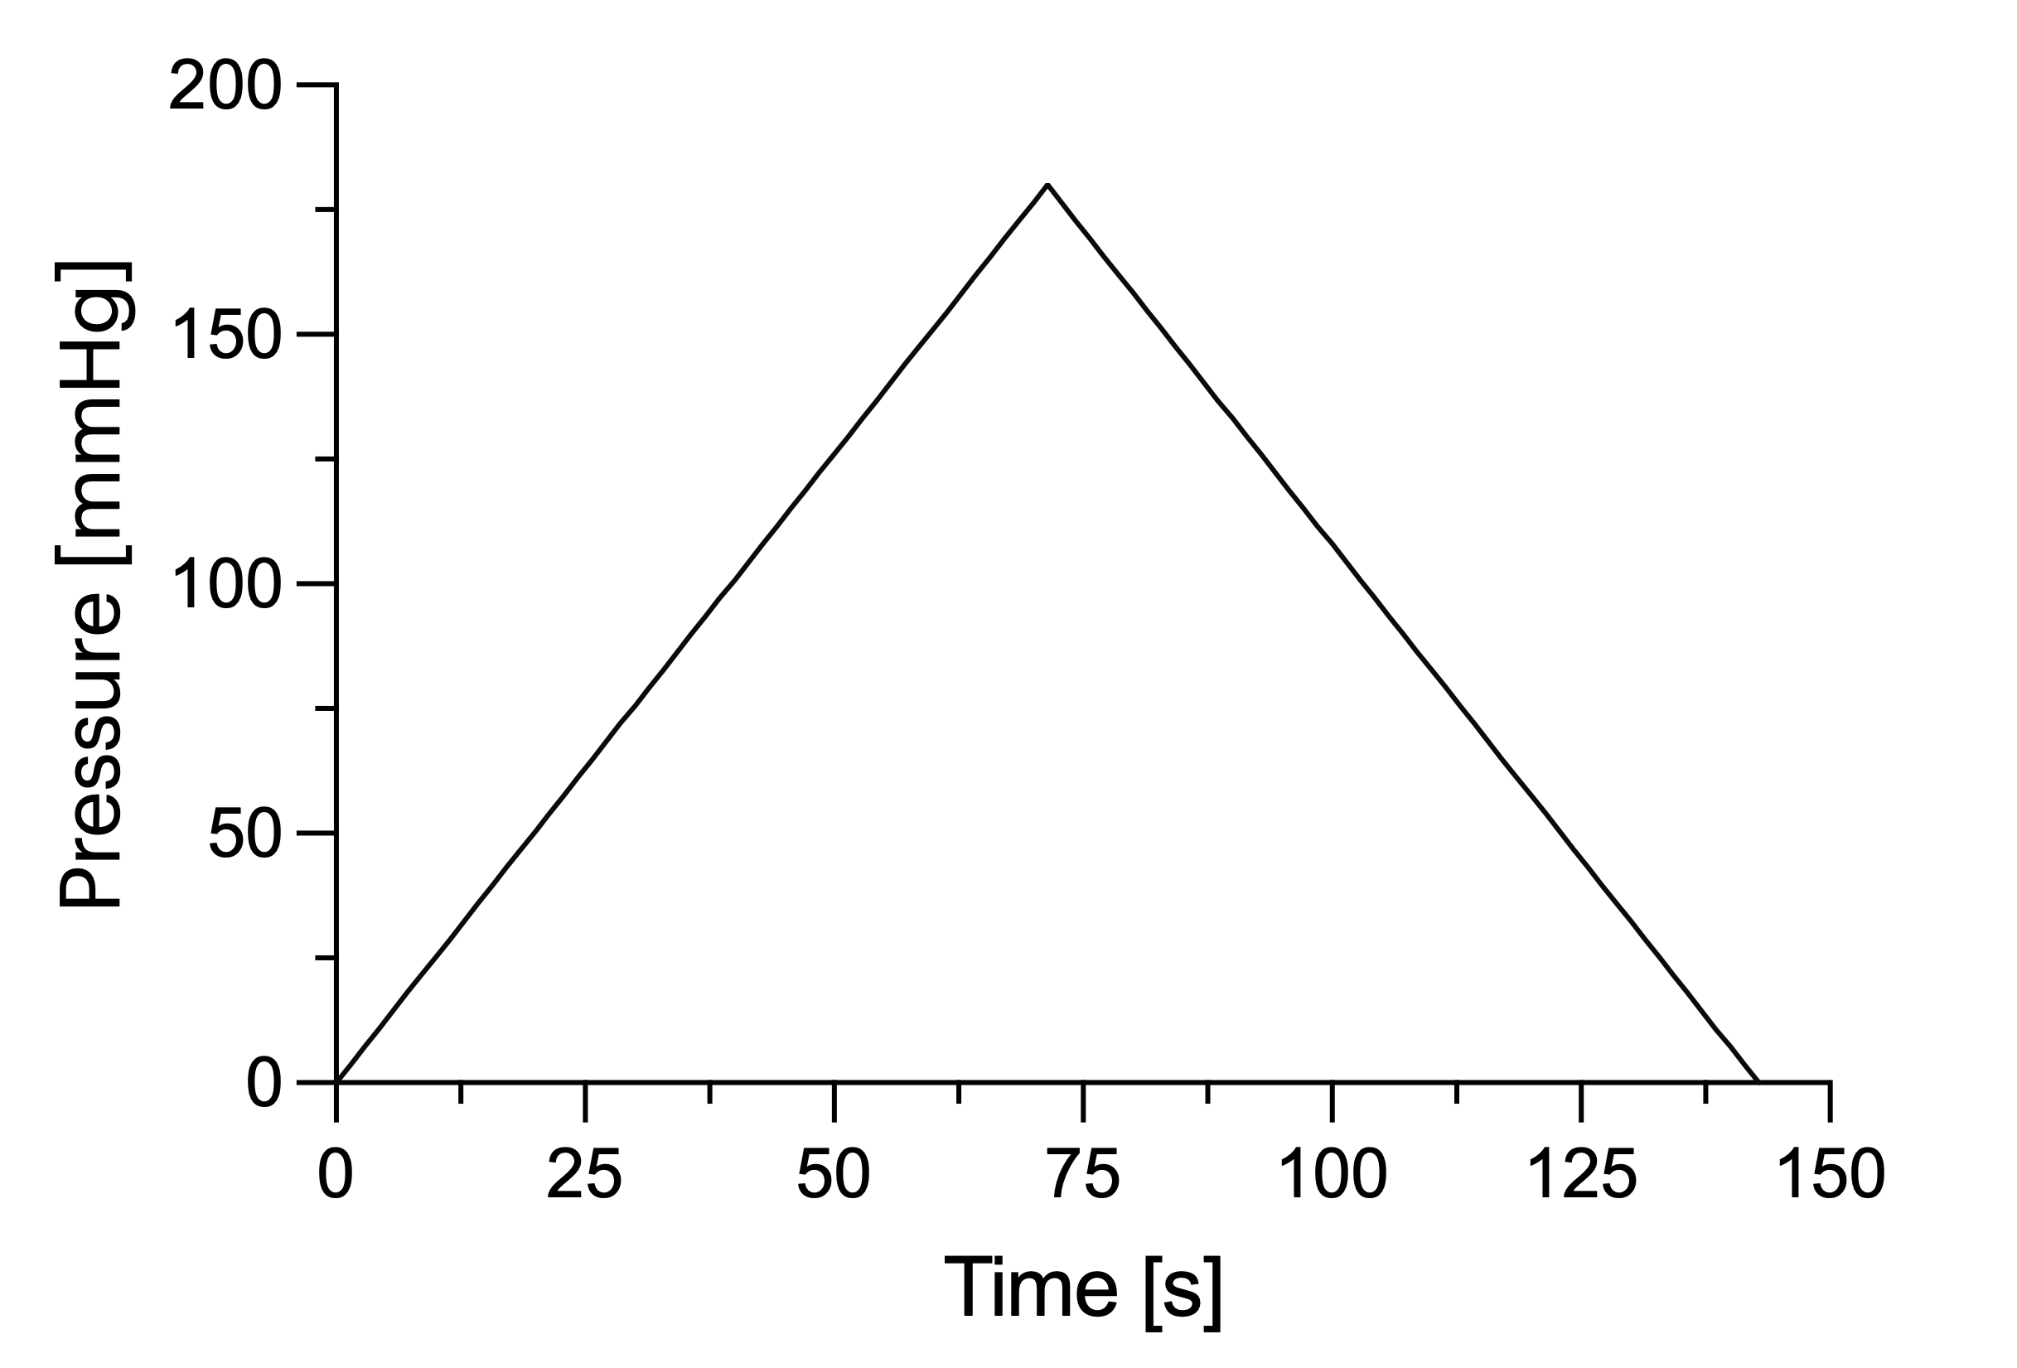
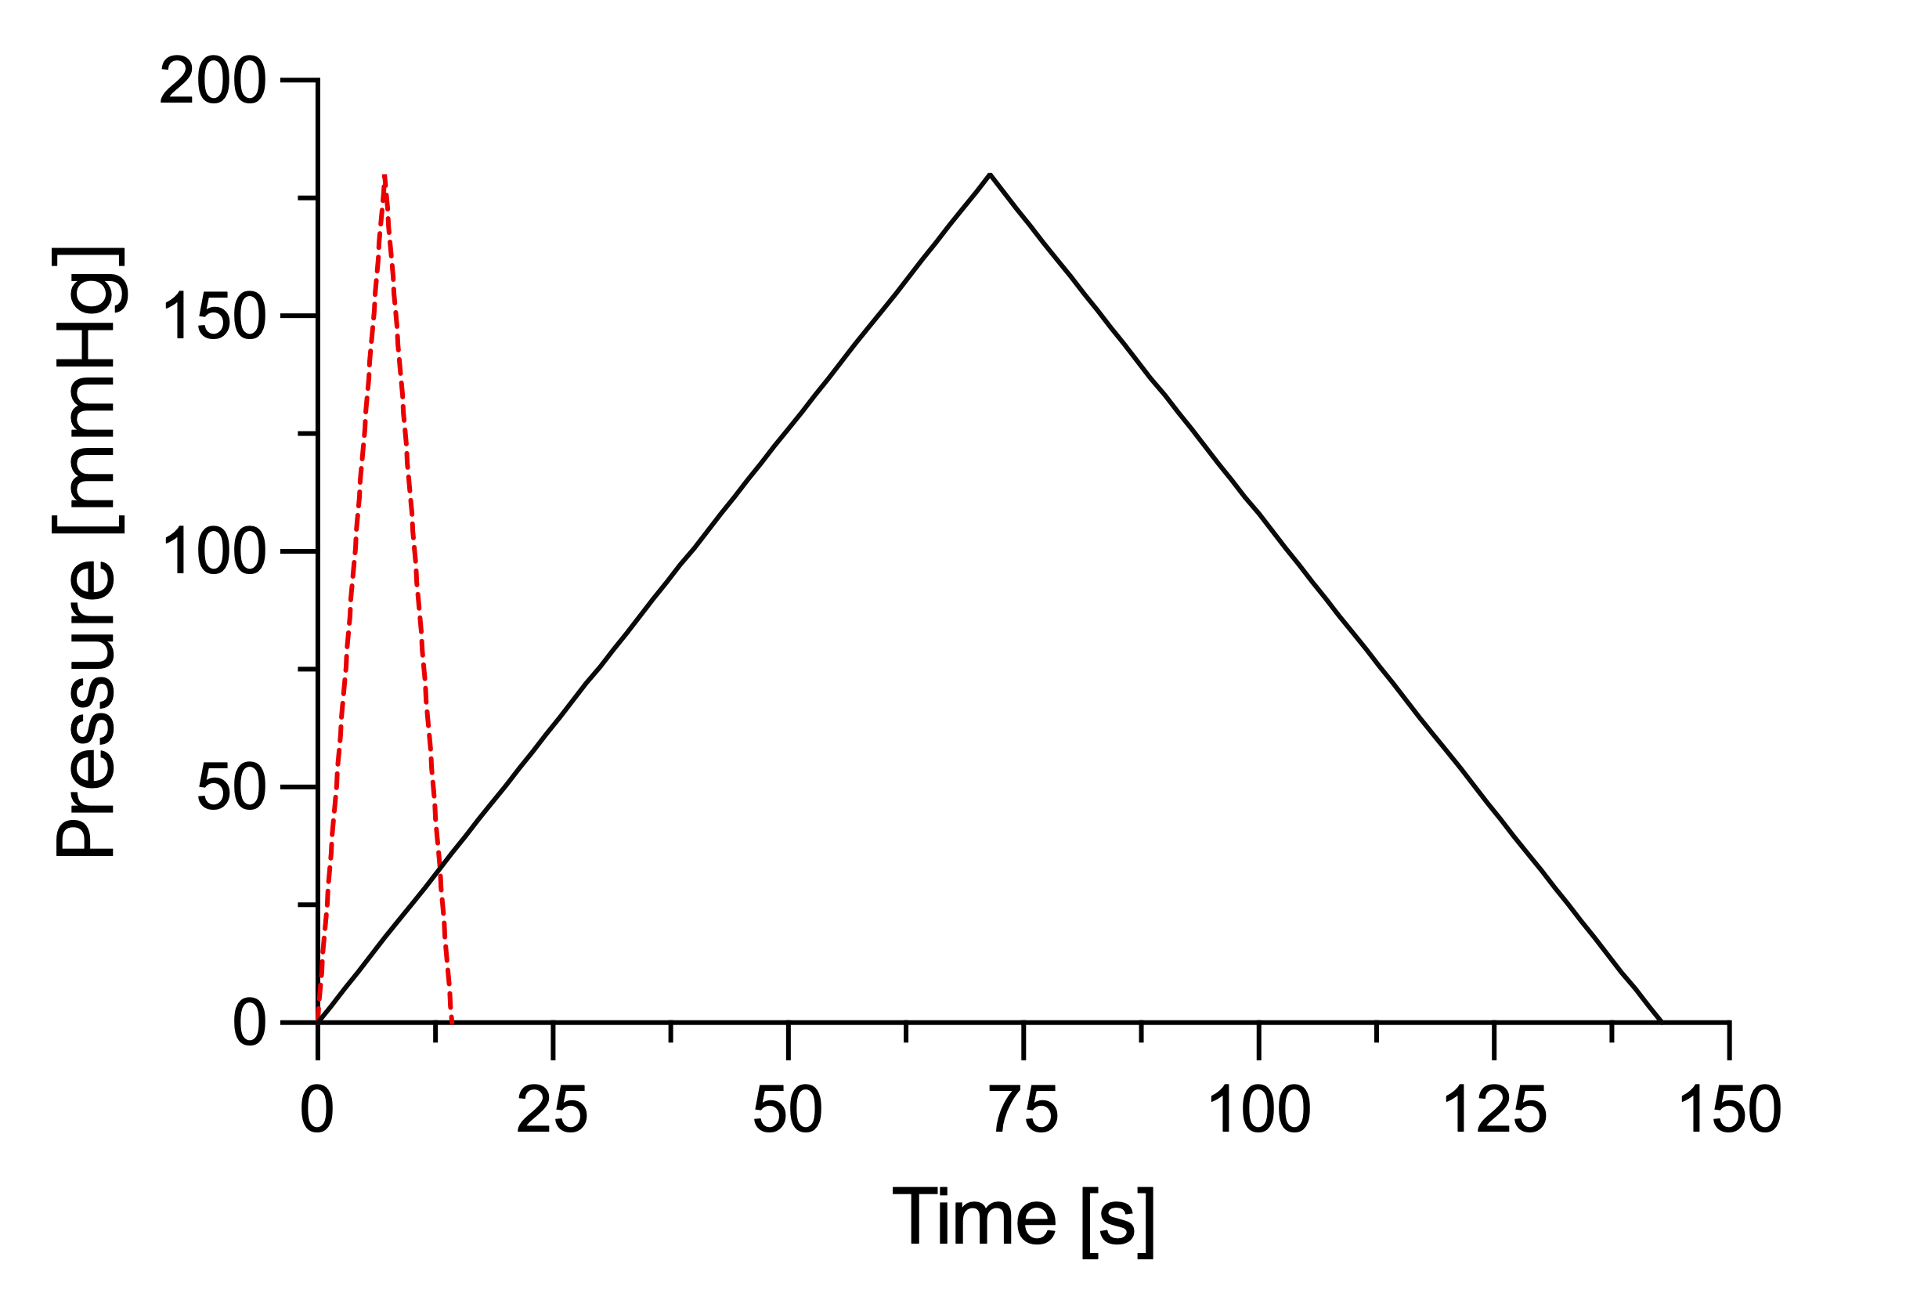
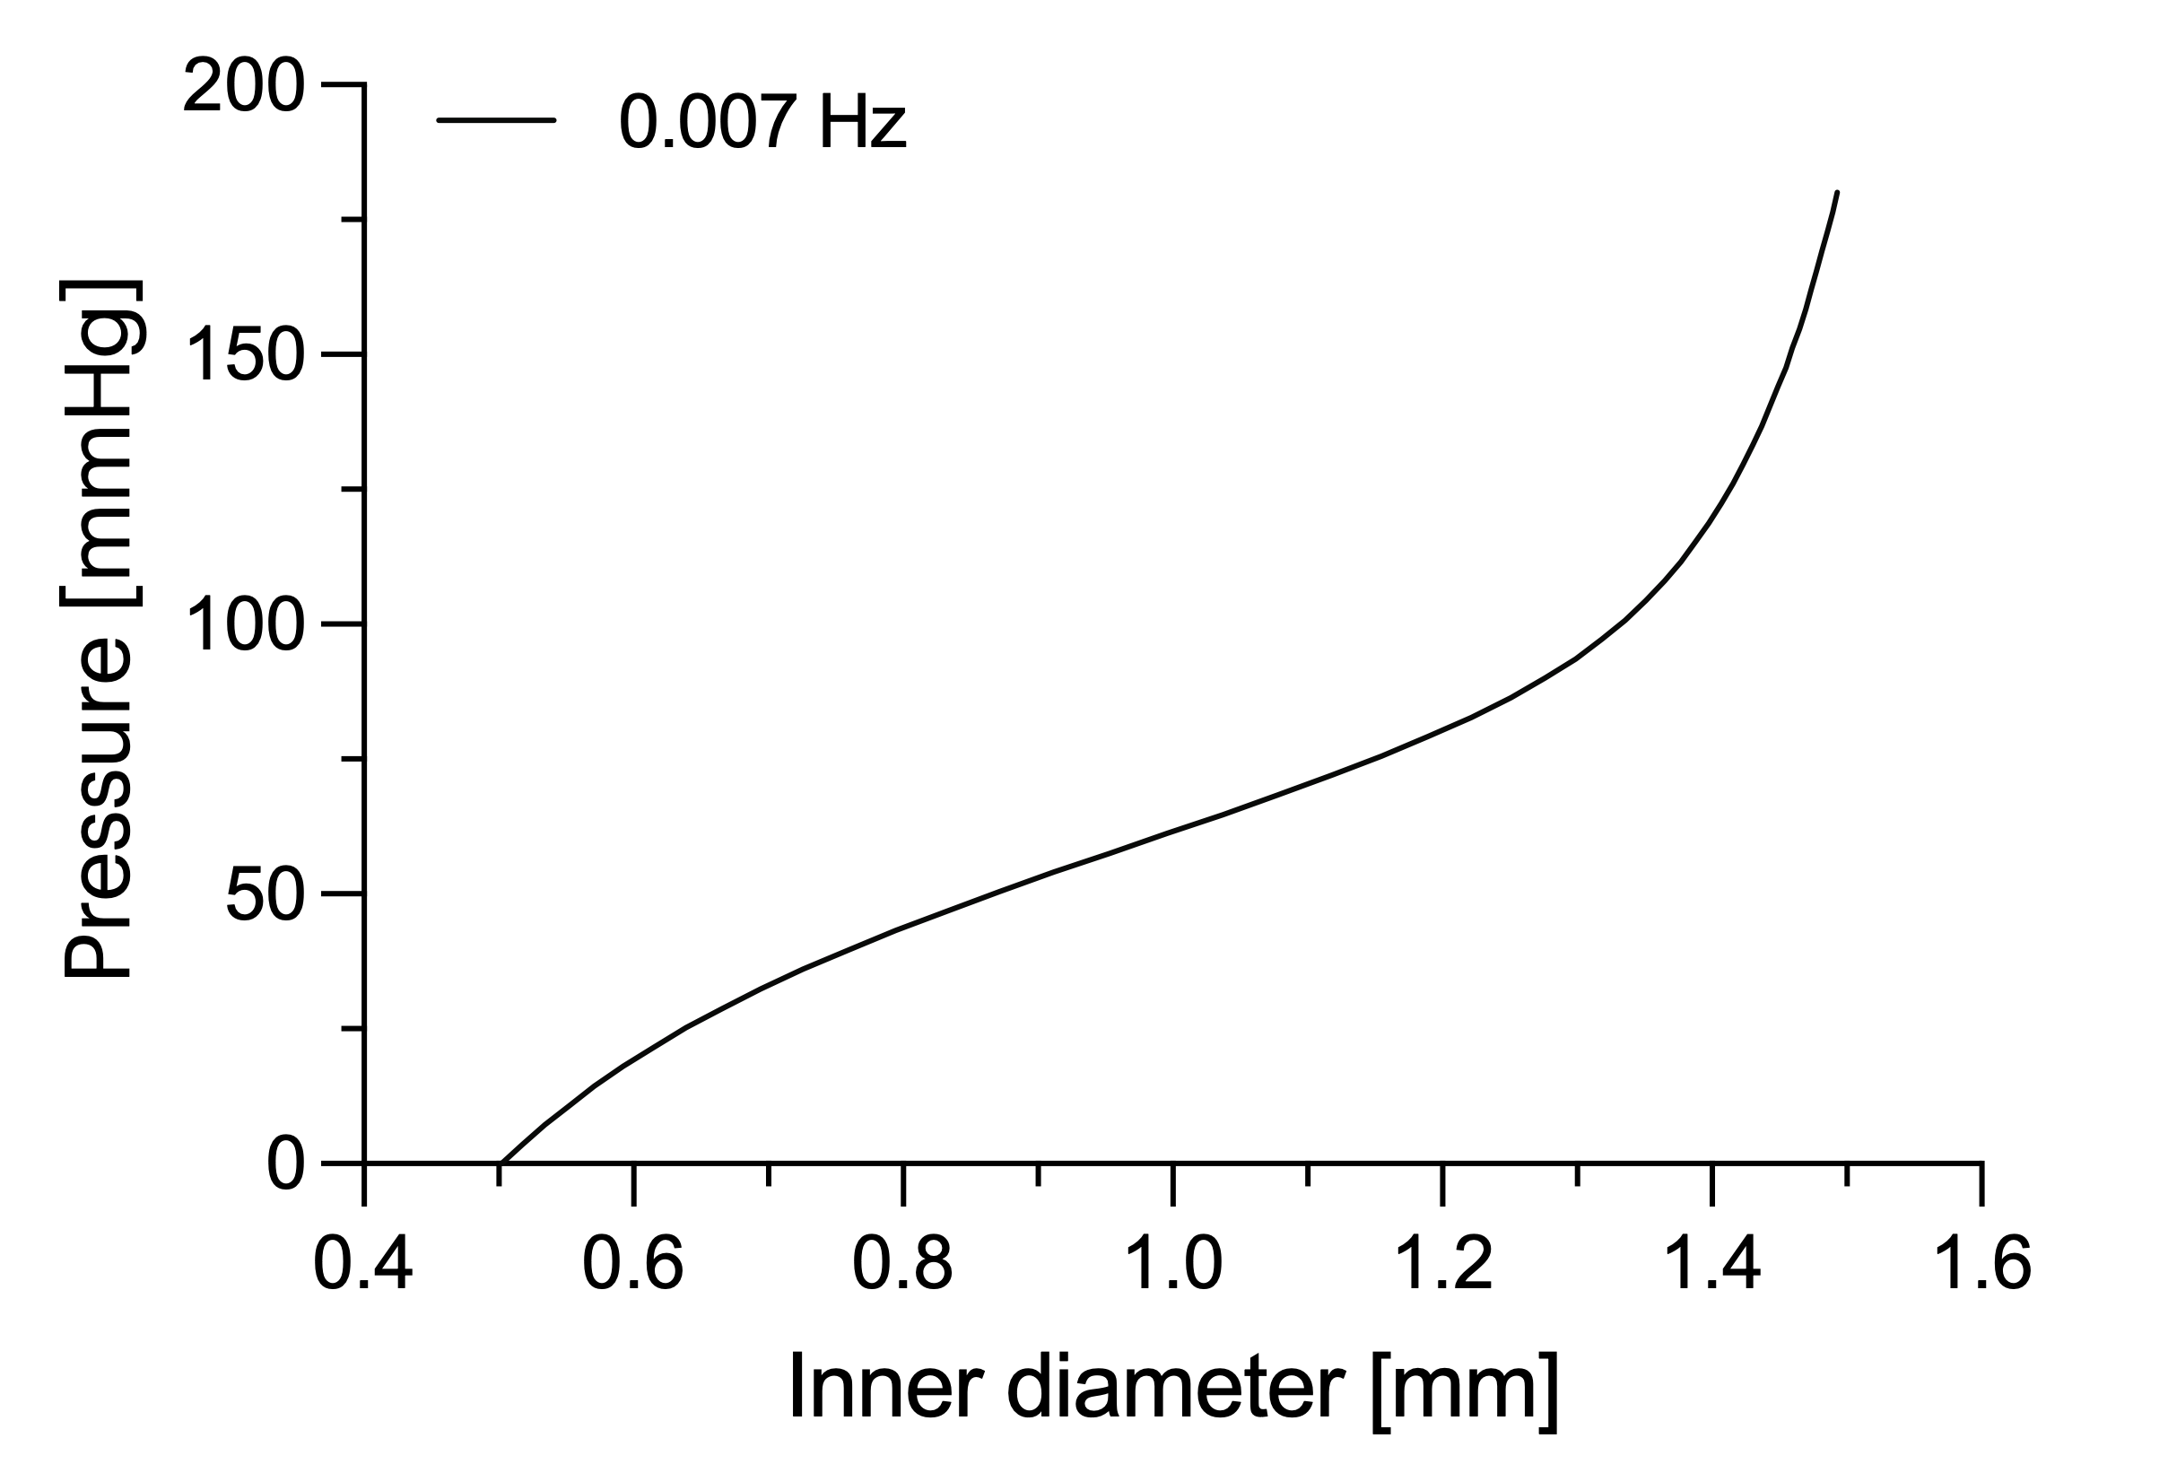
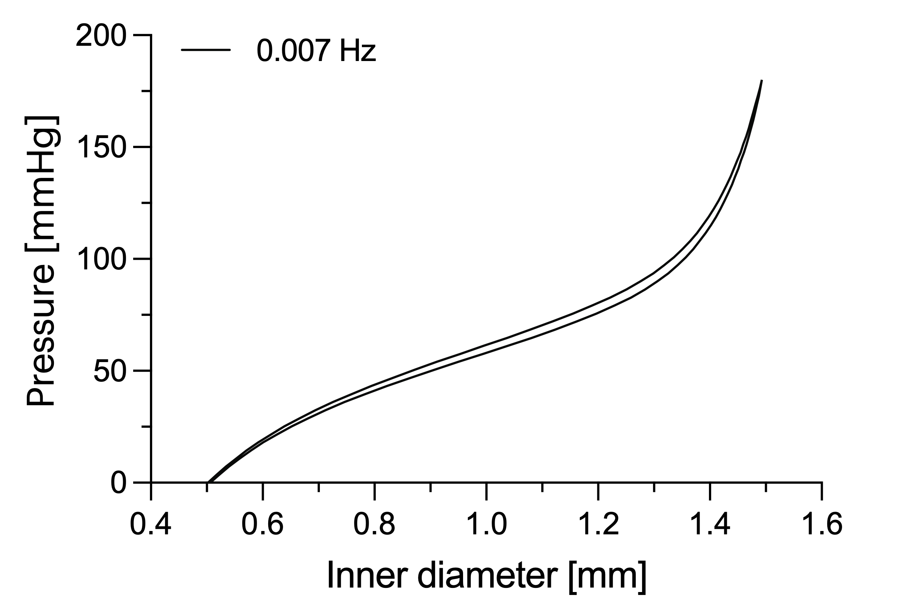
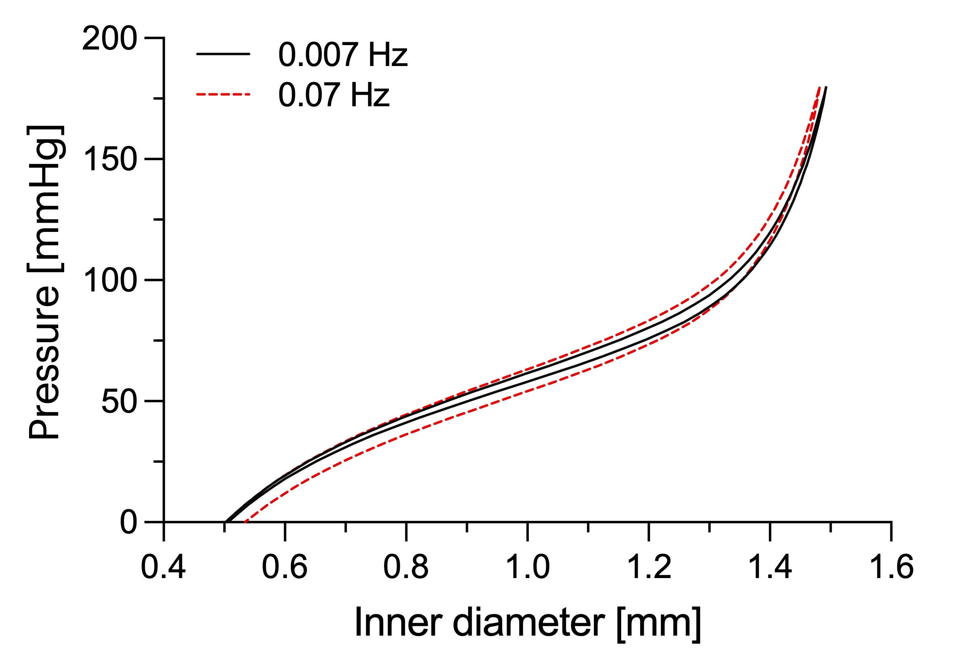
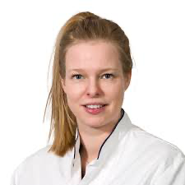
Viscoelasticity: Experimental observations
aorta
The loading rate affects the arterial response.
Myrthe van der Bruggen

Slide 9
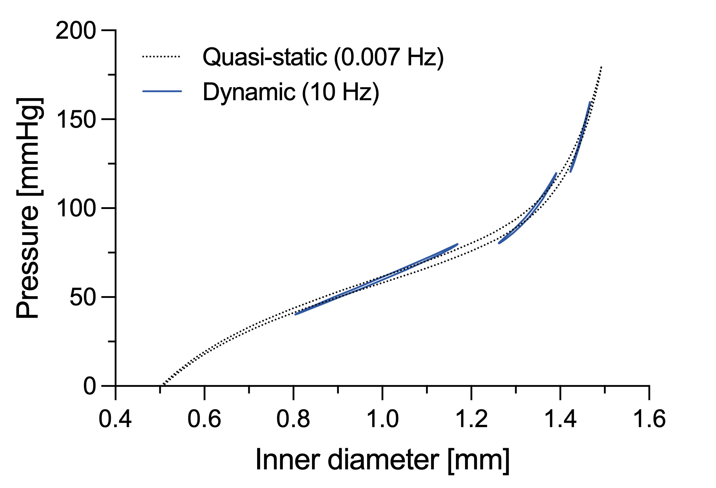
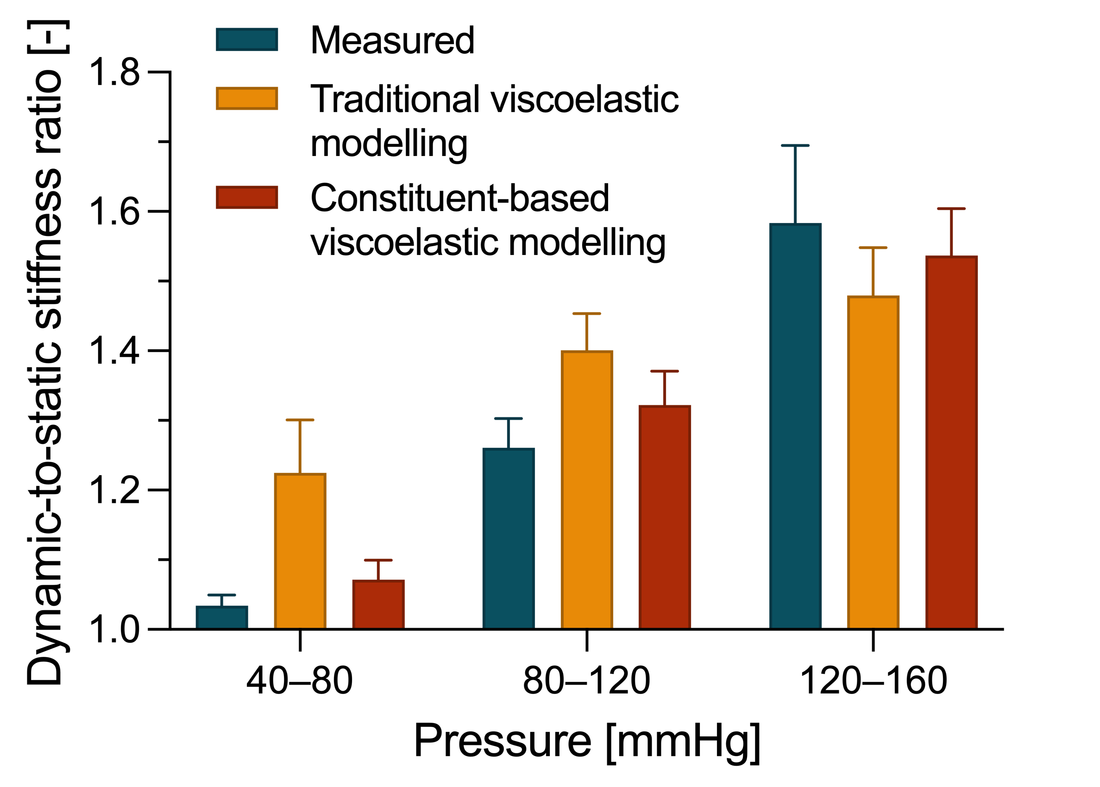
Viscoelasticity: Experimental observations
aorta
The loading rate affects the arterial response.
The stiffening effect is modulated by pressure.

Slide 10
Constituent-based quasi-linear viscoelasticity
Matrix elastic model
Collagen elastic model
$$+$$
Matrix viscoelastic
model
$$+$$
Collagen viscoelastic model
Elastic arterial model
Stress
Viscoelastic arterial model
Deformation independent viscoelastic behaviour
Strain
Deformation dependent viscoelastic behaviour?
Giudici, Biomech Mod Mechanobiol 2023, 22:1607-1623.

Slide 11
Constituent-based quasi-linear viscoelasticity
carotid
Viscoelastic collagen-dominated behaviour
=
Large stiffening
Elastic matrix-dominated behaviour
=
Small stiffening
Giudici, Biomech Mod Mechanobiol 2023, 22:1607-1623.

Slide 12
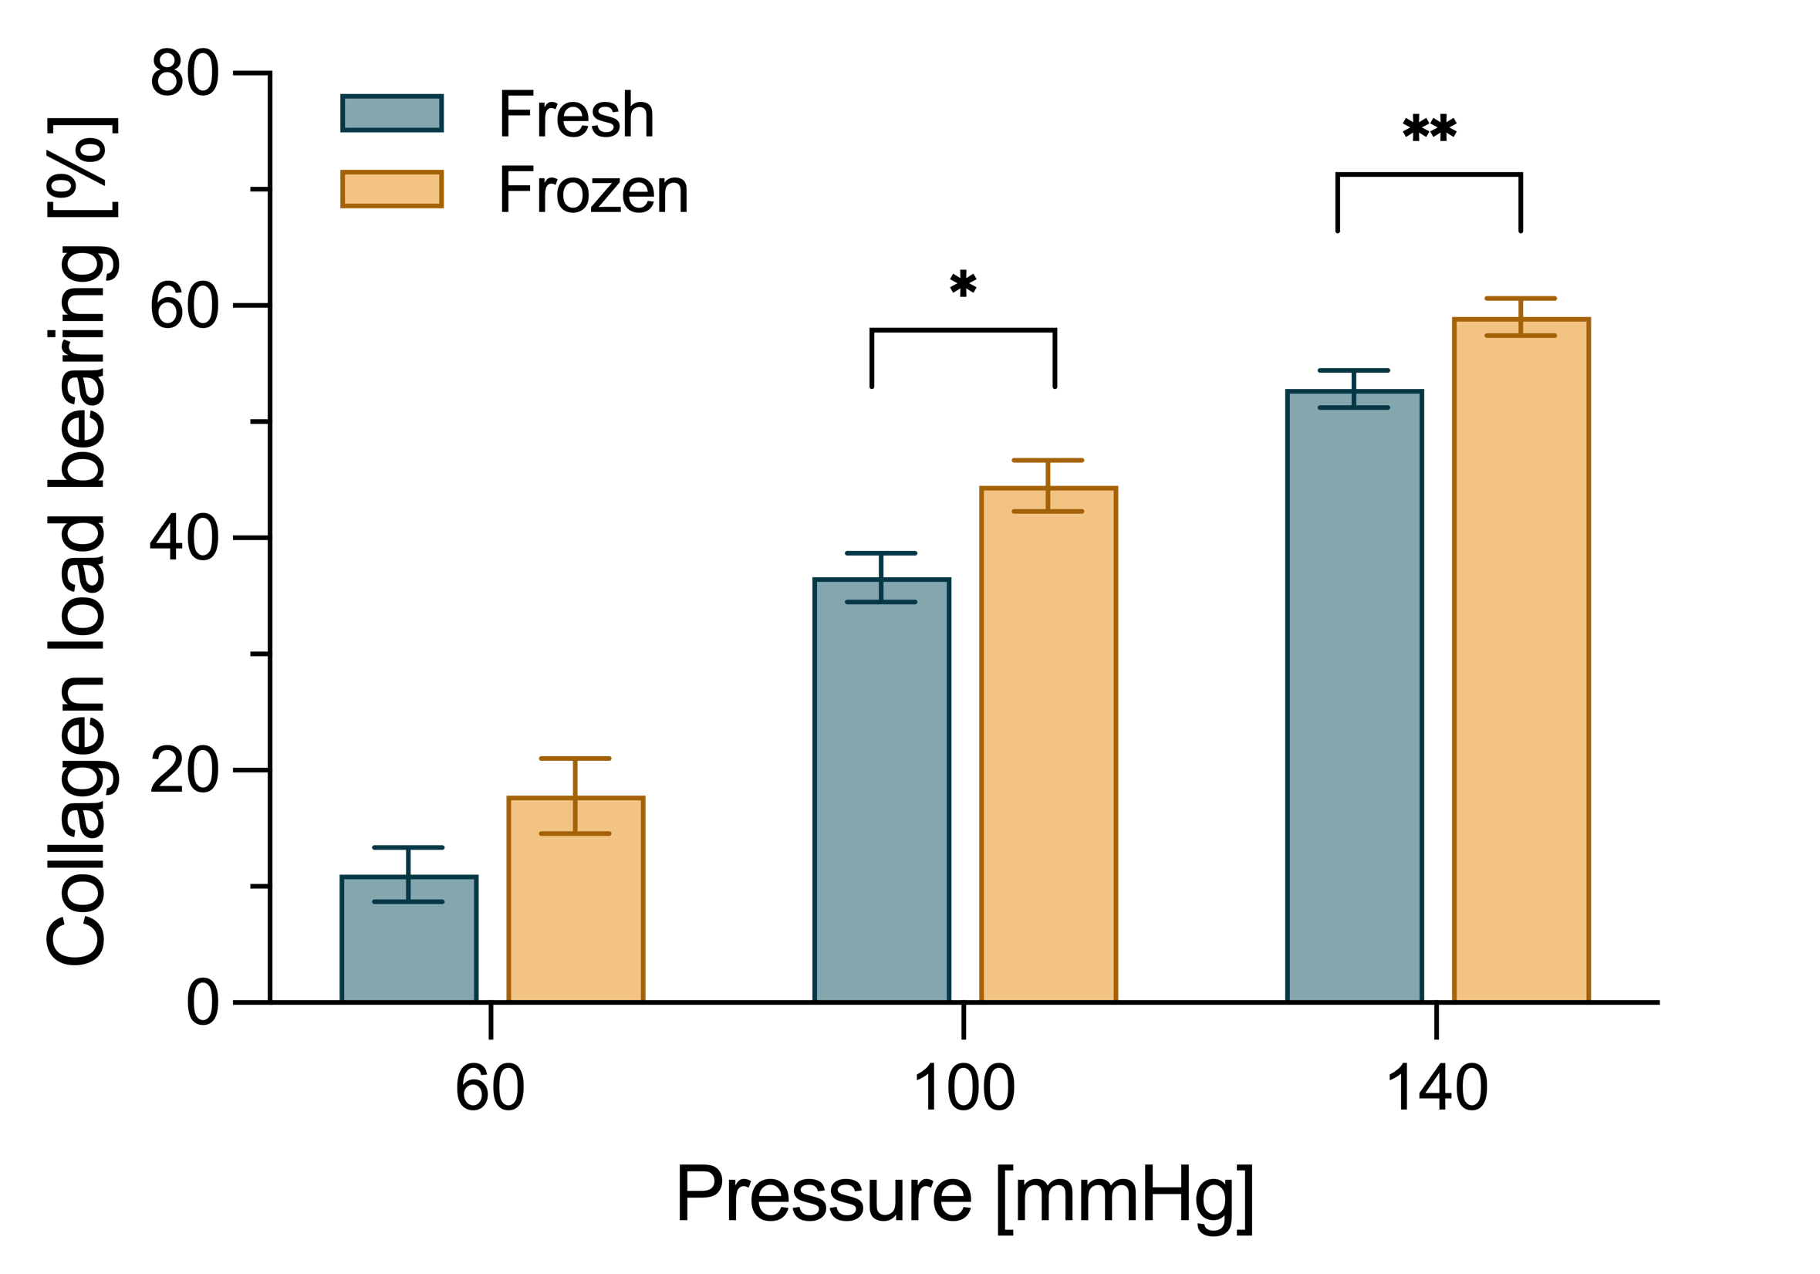
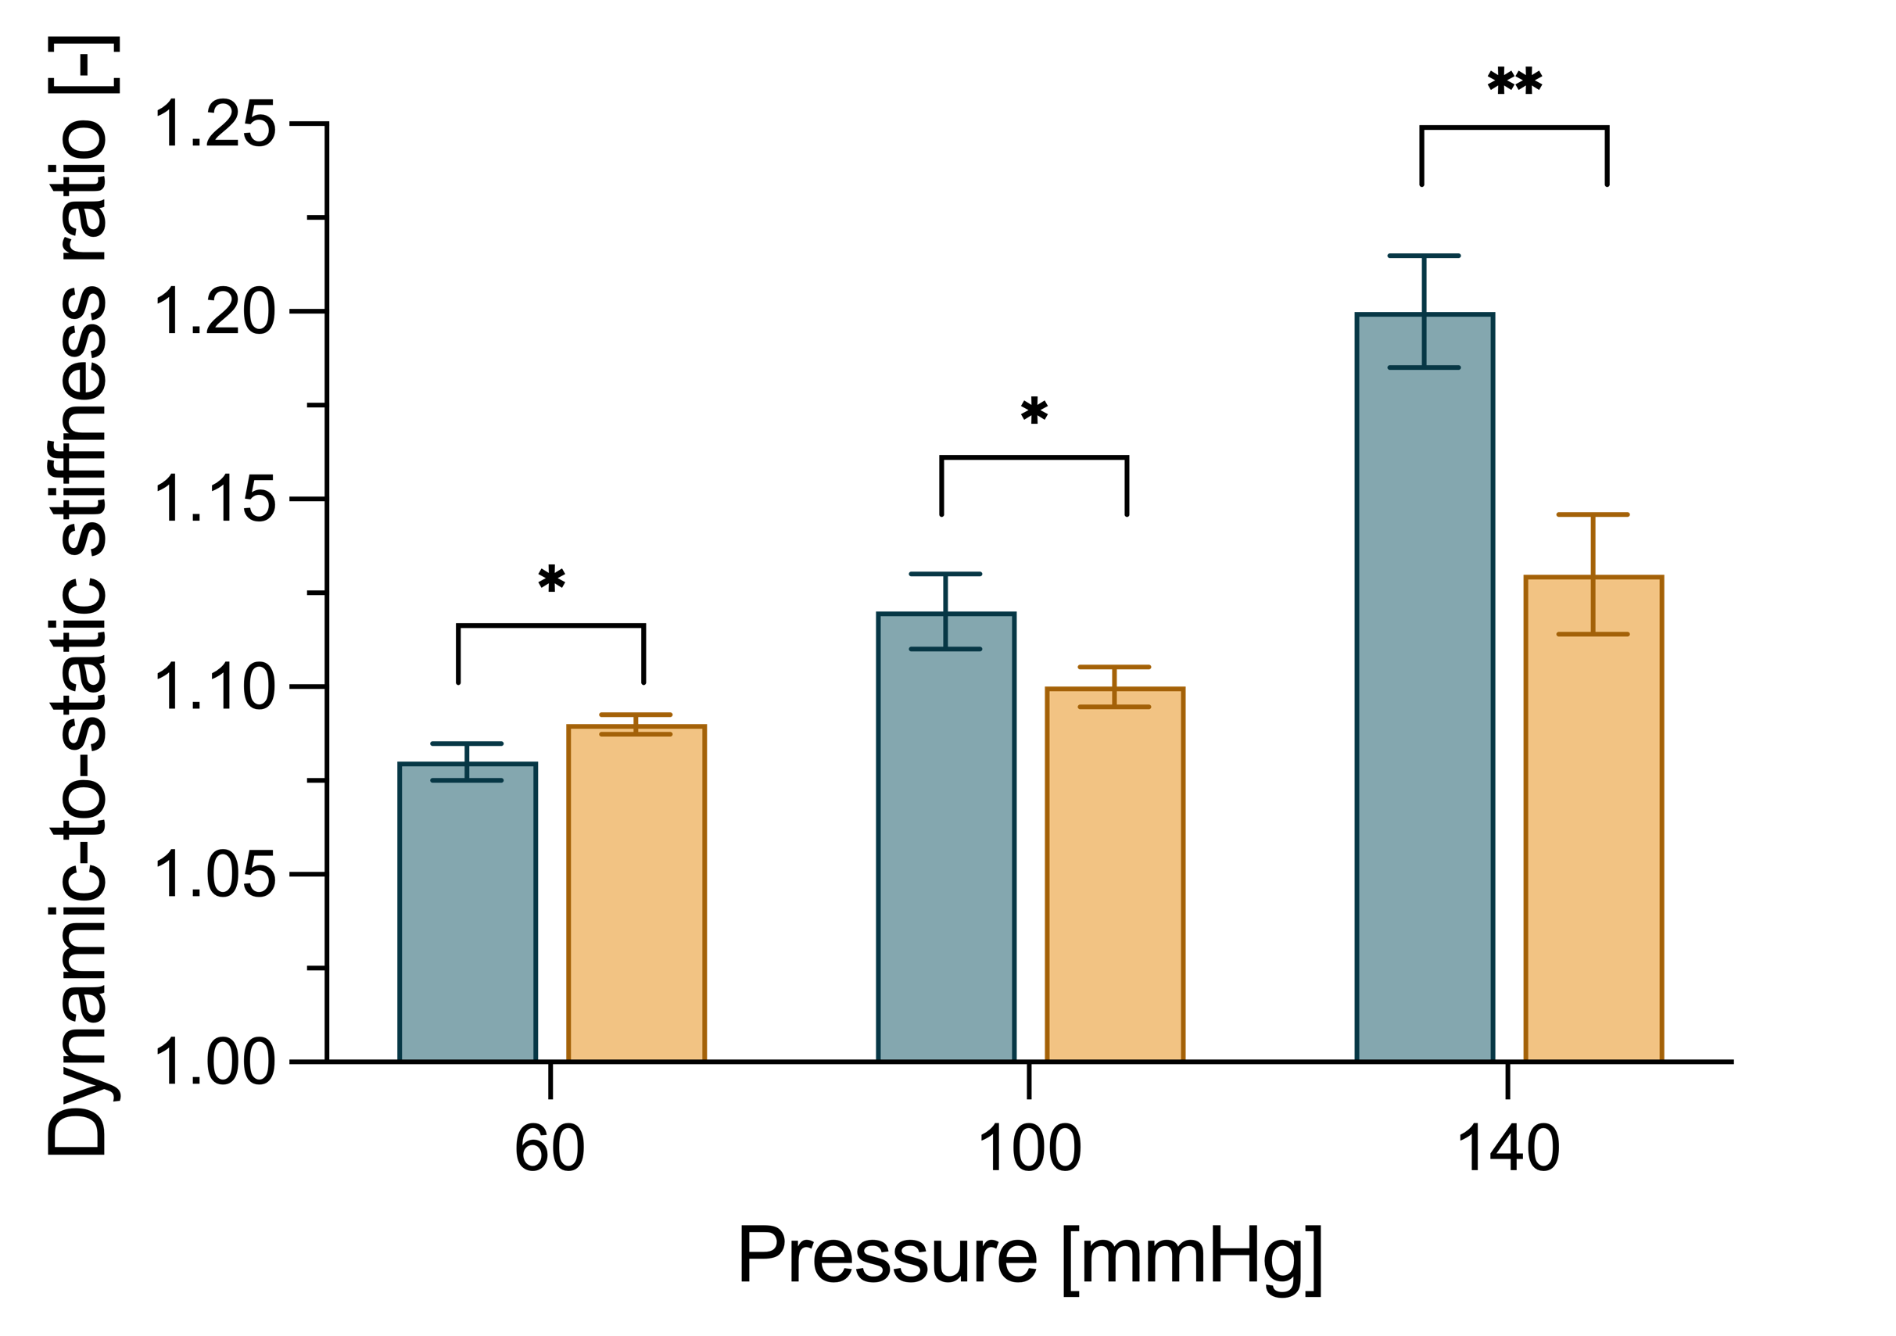
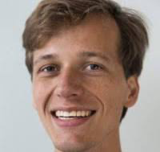
Examples: Freezing
aorta
Koen van der Laan
van der Laan,… Giudici, J Biomech 2024, 171:112190.

Slide 13
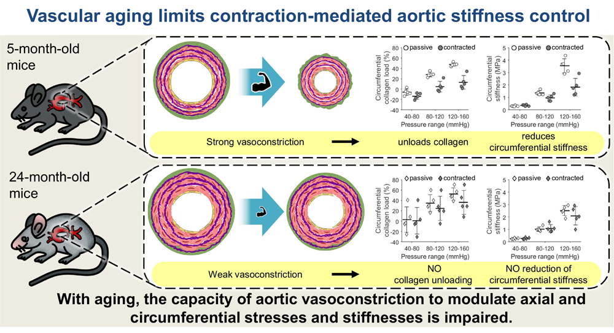

Examples: Ageing (in mice)
aorta
Cédric Neutel
Koen van der Laan
van der Laan, Neutel, …, Giudici. AJP – Cell 2025, 329(5):C1398-410.

Slide 14
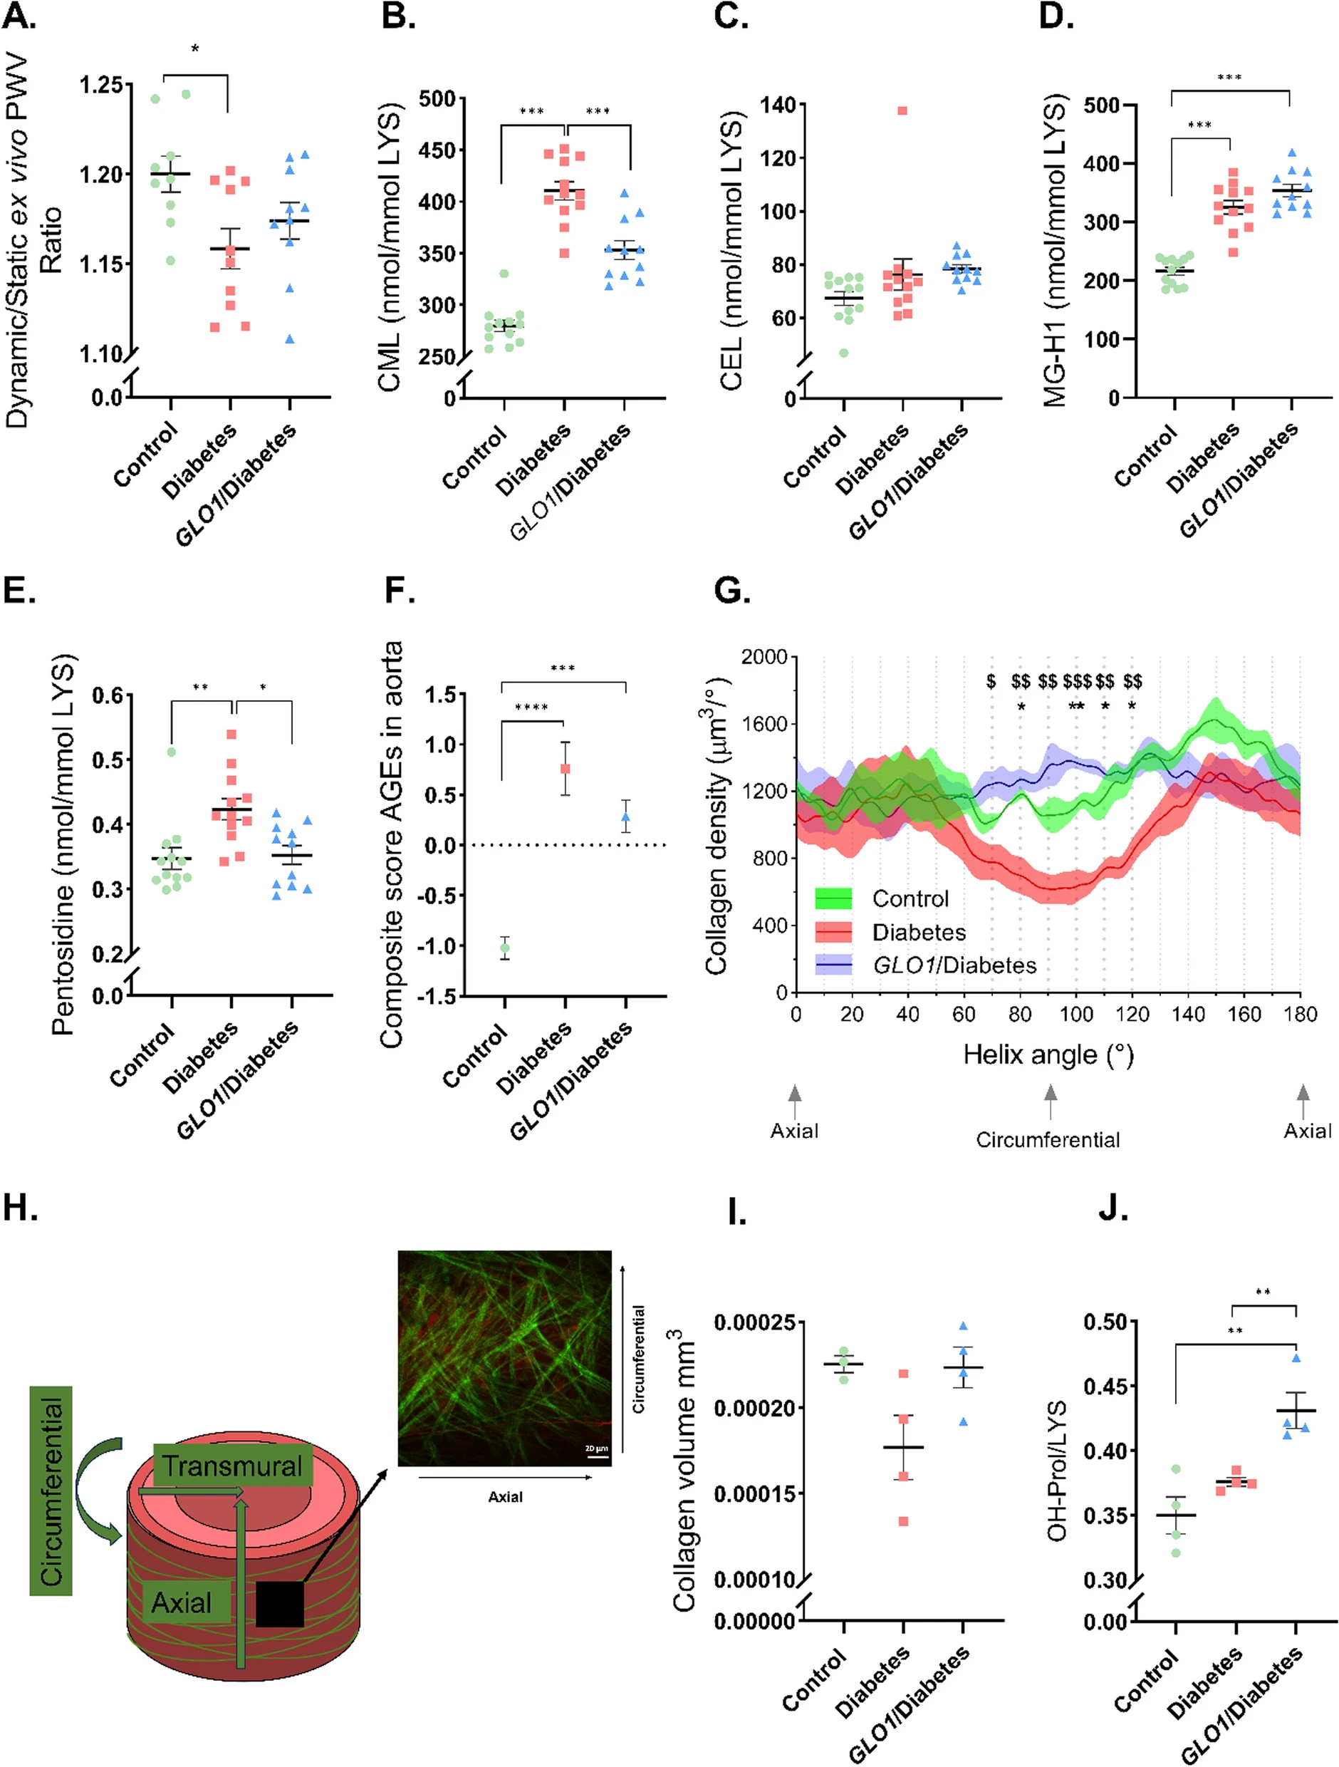
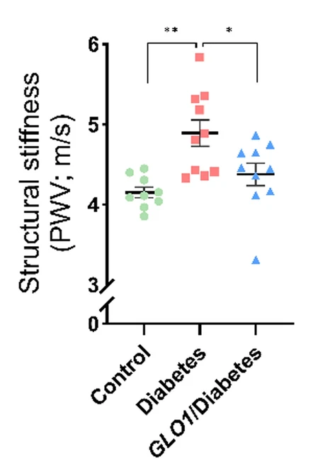
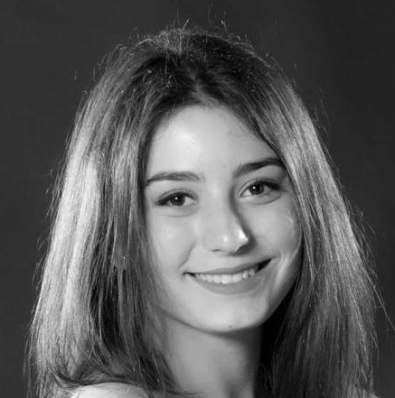
Examples: Diabetes and advanced glycation end products
aorta
Margarita Pencheva
Pencheva, …, Giudici,… Cardiovasc Diabetol 2025, 329(5):C1398-410.

Slide 15
Table of content:
Introduction
Thick- vs. thin-wall modelling
Experimental considerations
Viscoelasticity
Constitutive modelling in vivo

Slide 16
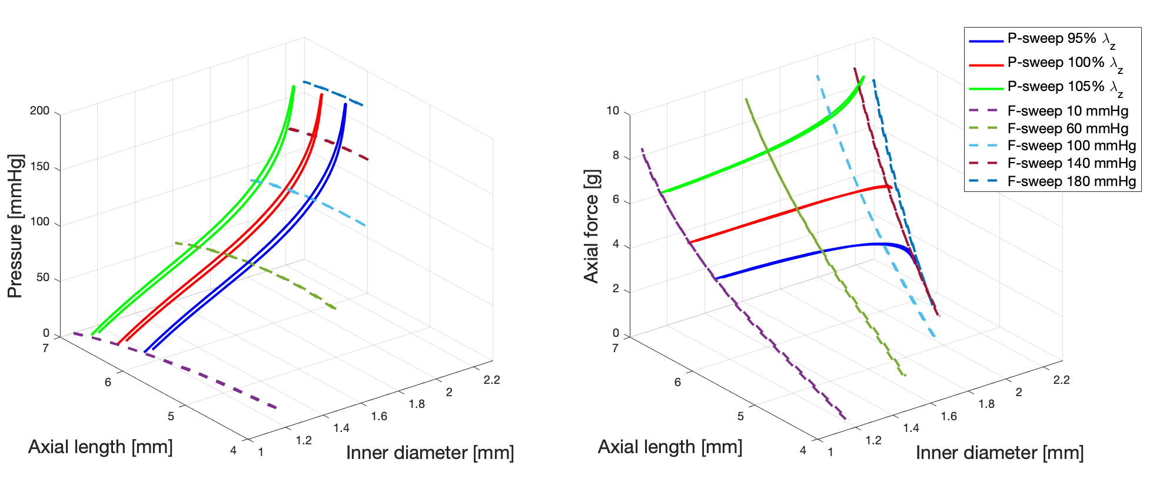

Sparse in vivo biomechanical data

Slide 17
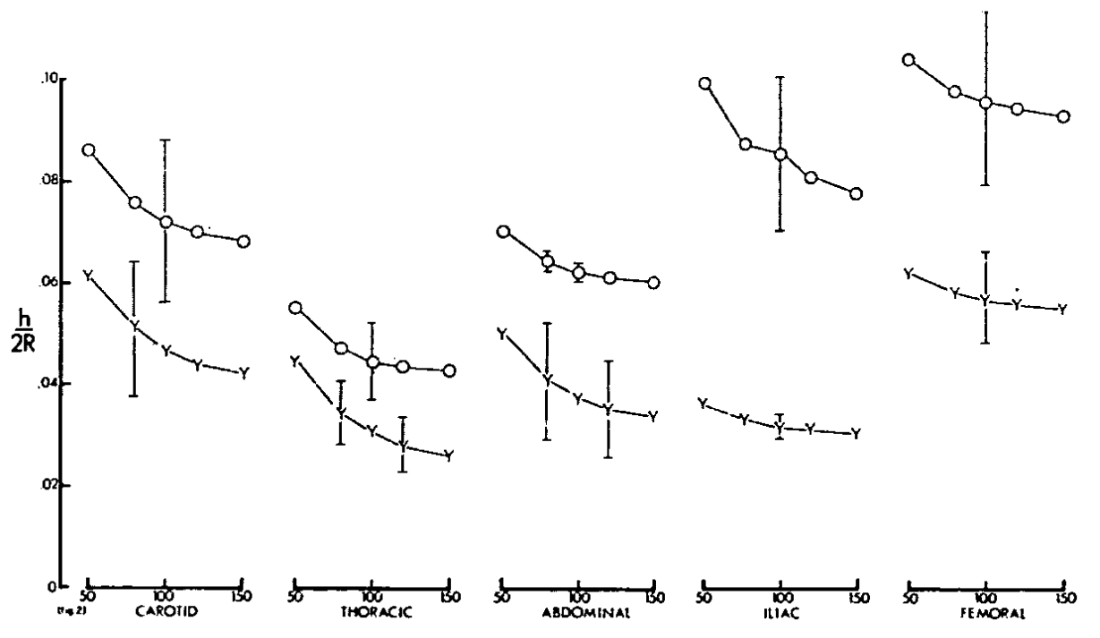







How to deal with the axial behaviour?
Constant pressure–force relationship.
Vascular homeostasis.
Y = young
O = old
$$σ_{θθ}≈σ_{zz}$$
Thickness-to-diameter ratio [-]
Pressure
Transducer force
Sommer, AJP Heart Circ Physiol 2009; 298:H898-912.
Giudici, J Mech Behav Biomed Mater 2023, 141:105752.
Inner diameter
Pressure
van der Laan, AJP Cell 2025, 329(5):C1398-410.
Pressure [mmHg]
Giudici, PhD Thesis 2021.
Learoyd. Circ Res 1966, 18(3):278-92.

Slide 18









Sparse in vivo biomechanical data
$$G_{c,carotid}$$
$$G_{e,carotid}$$
elastin
collagen
$$G_{e,femoral}$$
$$G_{c,femoral}$$
$$G_{VSMC,carotid}$$
$$G_{e,popliteal}$$
$$G_{f,popliteal}$$
$$G_{VSMC,femoral}$$
$$G_{VSMC,popliteal}$$
VSMCs

Slide 19


































Sparse in vivo biomechanical data
$$G_{c,carotid}$$
$$G_{e,carotid}$$
collagen
elastin
$$G_{c,carotid}$$
$$G_{e,femoral}$$
$$G_{e,carotid}$$
collagen
elastin
$$G_{c,femoral}$$
$$G_{VSMC,carotid}$$
$$G_{c,carotid}$$
$$G_{e,carotid}$$
$$G_{e,femoral}$$
elastin
collagen
$$G_{e,popliteal}$$
$$G_{c,carotid}$$
$$G_{e,carotid}$$
$$G_{c,femoral}$$
$$G_{VSMC,carotid}$$
collagen
$$G_{e,femoral}$$
elastin
$$G_{f,popliteal}$$
$$G_{VSMC,femoral}$$
$$G_{c,femoral}$$
$$G_{e,popliteal}$$
$$G_{VSMC,carotid}$$
$$G_{e,femoral}$$
$$G_{c,femoral}$$
$$G_{VSMC,carotid}$$
$$G_{f,popliteal}$$
$$G_{VSMC,femoral}$$
$$G_{e,popliteal}$$
$$G_{VSMC,popliteal}$$
$$G_{f,popliteal}$$
$$G_{VSMC,femoral}$$
$$G_{e,popliteal}$$
VSMCs
$$G_{f,popliteal}$$
$$G_{VSMC,popliteal}$$
$$G_{VSMC,femoral}$$
VSMCs
$$G_{VSMC,popliteal}$$
Time
VSMCs
$$G_{VSMC,popliteal}$$
VSMCs

Slide 20





In vivo biomechanics: How to deal with limited data?
60-day head down bead rest (HDBR) study:
Measurements at the carotid, femoral, and popliteal artery.
Tonometer pressure and ultrasound diameter and IMT.
Boutouyrie, J Hypertens 2022, 40: 2058–2067.
Carotid artery
Femoral artery
Popliteal artery
HDBR
Day 29
HDBR
Day 52
Recovery
Day 12
Recovery
Day 30
Baseline

Slide 21

We are hiring!

Slide 22





QUESTIONS?
a.giudici@maastrichtuniversity.nl
Biomedical Engineering
Bart Spronck
Koen Reesink
Tammo Delhaas
Cédric Neutel
Mobina Izadpanah
Myrthe van der Bruggen
Koen van der Laan
Cindy van Loo
Internal Medicine
Margarita Pencheva
Casper Schalkwijk
Paris Cardiovascular
Research Centre
Pierre Boutouyrie
Rosa Maria Bruno
Biochemistry
Leon Schurgers
Durham University
Ashraf Khir
Cambridge University
Ian Wilkinson
University of Amsterdam
Shaiv Parikh
Yale University
Jay Humphrey
Carnegie Mellon University
Jason Szafron
Iowa State University
Abhay Ramachandra

